Slide 1

CS 484 Intro to Machine Learning
Week 7
October 7, 2020

Slide 2
Week 7 Agenda: Learner Evaluation, Logistic Regression
Gain and Lift
Precision and Recall
Multinomial Logistic Regression
Forward / Backward Feature Selection
Chapter 6,7,8 of the Machine Learning book

Slide 3
Gain and Lift: Statement of Problem
I built a model to predict a customer’s likelihood to respond to my market campaign
I should contact the customers who are more likely to respond according to the model
How should I choose the customers to contact?
What percentage of customers should I contact?
I have limited resources (e.g., budget, time)
What will be the response rate of the customers?

Slide 4
Gain and Lift: Motivations
If my model works, then the customers with higher predicted Event probabilities are more likely to respond than the customers with lower predicted Event probabilities.
An idea is to divide customers into groups of decreasing predicted Event probabilities and then study the response rates of these groups.
Ideally, the first few groups should contain the “more preferred” customers.

Slide 5
Gain and Lift: Algorithm
Score Model
Calculate the predicted event probabilities
Sort the probabilities in descending order
Create Deciles
Divide the probabilities into ten equal-count deciles
Calculate Statistics
Calculate the Response Rate, the Gain, and the Lift in each decile
Decile 1 contains the top 10% of predicted probabilities
Decile 10 contains the bottom 10% of predicted probabilities
Determine the actual count in each decile

Slide 6
Gain and Lift: Column Statistics
Decile N: Number of observations in the decile
Decile %: Percent of observations in the decile (base = all observations)
Gain N: Number of observations of the target Event category in the decile
Gain %: Percent of Event observations in the decile (base = all Event observations)
Response %: Percent of Event observations in the decile (based = observations in decile)
Lift: Response % divided by the overall percentage of the target category

Slide 7
Accumulated Gain and Lift: Column Statistics (Accumulated Decile = Lower Deciles + Current Decile)
Accumulated Decile N: Number of observations in the accumulated decile
Accumulated Decile %: Percent of observations in the accumulated decile (base = all observations)
Accumulated Gain N: Number of observations of the target Event category in the accumulated decile
Accumulated Gain %: Percent of Event observations in the accumulated decile (base = all Event observations)
Accumulated Response %: Percent of Event observations in the accumulated decile (based = observations in decile)
Accumulated Lift: accumulated response % divided by the overall percentage of the target category

Slide 8
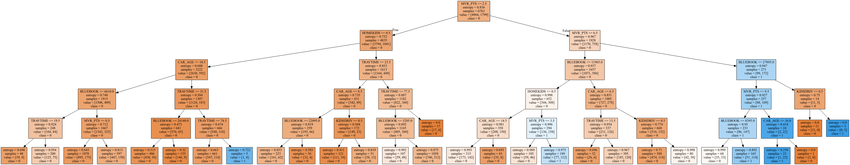
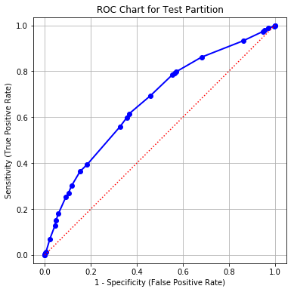
Gain and Lift: CART Model
Binary Target: CLAIM_FLAG Event category is 1 Non-Event category is 0
Interval Predictors: BLUEBOOK, CAR_AGE, HOMEKIDS, KIDSDRIV, MVR_PTS, and TRAVTIME
Training: 6,763 observations
Test: 2,899 observations
Predicted Event Probability: pCLAIM_FLAG_1
Week 7 Gain Lift.py

Slide 9
Gain and Lift: CART Model on Test Partition
Decile | Decile N | Decile % | Gain N | Gain % | Response % | Lift
1 | 263 | 9.07 | 138 | 17.90 | 52.47 | 1.97
2 | 216 | 7.45 | 94 | 12.19 | 43.52 | 1.64
3 | 214 | 7.38 | 71 | 9.21 | 33.18 | 1.25
4 | 431 | 14.87 | 127 | 16.47 | 29.47 | 1.11
5 | 130 | 4.48 | 44 | 5.71 | 33.85 | 1.27
6 | 259 | 8.93 | 61 | 7.91 | 23.55 | 0.89
7 | 317 | 10.93 | 80 | 10.38 | 25.24 | 0.95
8 | 283 | 9.76 | 49 | 6.36 | 17.31 | 0.65
9 | 441 | 15.21 | 55 | 7.13 | 12.47 | 0.47
10 | 345 | 11.90 | 52 | 6.74 | 15.07 | 0.57
Overall | 2899 | 100.00 | 771 | 100.00 | 26.60 | 1

Slide 10
Gain and Lift: CART Model on Test Partition
Decile | Decile N | Decile % | Gain N | Gain % | Response % | Lift
1 | 263 | 9.07 | 138 | 17.90 | 52.47 | 1.97
2 | 216 | 7.45 | 94 | 12.19 | 43.52 | 1.64
3 | 214 | 7.38 | 71 | 9.21 | 33.18 | 1.25
4 | 431 | 14.87 | 127 | 16.47 | 29.47 | 1.11
5 | 130 | 4.48 | 44 | 5.71 | 33.85 | 1.27
6 | 259 | 8.93 | 61 | 7.91 | 23.55 | 0.89
7 | 317 | 10.93 | 80 | 10.38 | 25.24 | 0.95
8 | 283 | 9.76 | 49 | 6.36 | 17.31 | 0.65
9 | 441 | 15.21 | 55 | 7.13 | 12.47 | 0.47
10 | 345 | 11.90 | 52 | 6.74 | 15.07 | 0.57
Overall | 2899 | 100.00 | 771 | 100.00 | 26.60 | 1
138 observations with Response = 1 in Decile 1
138/771 = 17.90%
138 / 263 = 52.47%
52.47 / 26.60 = 1.97

Slide 11
Gain and Lift: Week 7 Gain Lift.py
# The Gain and Lift function
def compute_lift_coordinates (
DepVar, # The column that holds the dependent variable's values
EventValue, # Value of the dependent variable that indicates an event
EventPredProb, # The column that holds the predicted event probability
Debug = 'N'): # Show debugging information (Y/N)
# Find out the number of observations
nObs = len(DepVar)
# Get the quantiles
quantileCutOff = numpy.percentile(EventPredProb, numpy.arange(0, 100, 10))
nQuantile = len(quantileCutOff)
quantileIndex = numpy.zeros(nObs)
for i in range(nObs):
iQ = nQuantile
EPP = EventPredProb[i]
for j in range(1, nQuantile):
if (EPP > quantileCutOff[-j]):
iQ -= 1
quantileIndex[i] = iQ

Slide 12
Gain and Lift: Week 7 Gain Lift.py
# Construct the Lift chart table
countTable = pandas.crosstab(quantileIndex, DepVar)
decileN = countTable.sum(1)
decilePct = 100 * (decileN / nObs)
gainN = countTable[EventValue]
totalNResponse = gainN.sum(0)
gainPct = 100 * (gainN /totalNResponse)
responsePct = 100 * (gainN / decileN)
overallResponsePct = 100 * (totalNResponse / nObs)
lift = responsePct / overallResponsePct
LiftCoordinates = pandas.concat([decileN, decilePct, gainN, gainPct, responsePct, lift],
axis = 1, ignore_index = True)
LiftCoordinates = LiftCoordinates.rename({0:'Decile N',
1:'Decile %',
2:'Gain N',
3:'Gain %',
4:'Response %',
5:'Lift'}, axis = 'columns')

Slide 13
Gain and Lift: Week 7 Gain Lift.py
# Construct the Accumulative Lift chart table
accCountTable = countTable.cumsum(axis = 0)
decileN = accCountTable.sum(1)
decilePct = 100 * (decileN / nObs)
gainN = accCountTable[EventValue]
gainPct = 100 * (gainN / totalNResponse)
responsePct = 100 * (gainN / decileN)
lift = responsePct / overallResponsePct
accLiftCoordinates = pandas.concat([decileN, decilePct, gainN, gainPct, responsePct, lift],
axis = 1, ignore_index = True)
accLiftCoordinates = accLiftCoordinates.rename({0:'Acc. Decile N',
1:'Acc. Decile %',
2:'Acc. Gain N',
3:'Acc. Gain %',
4:'Acc. Response %',
5:'Acc. Lift'}, axis = 'columns')
return(LiftCoordinates, accLiftCoordinates)

Slide 14
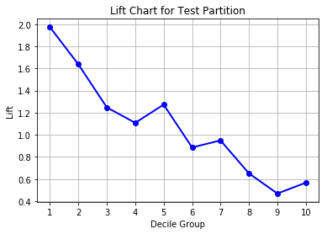
Gain and Lift: Interpretation
If we only contact the top 10% of customers, then 52.47% of them will respond. This response rate is 1.97 times the overall rate.
If we only contact the next 10% of customers, then 43.52% of them will respond. This response rate is 1.64 times the overall rate.
Decile | Decile N | Decile % | Gain N | Gain % | Response % | Lift
1 | 263 | 9.07 | 138 | 17.90 | 52.47 | 1.97
2 | 216 | 7.45 | 94 | 12.19 | 43.52 | 1.64
3 | 214 | 7.38 | 71 | 9.21 | 33.18 | 1.25
4 | 431 | 14.87 | 127 | 16.47 | 29.47 | 1.11
5 | 130 | 4.48 | 44 | 5.71 | 33.85 | 1.27
6 | 259 | 8.93 | 61 | 7.91 | 23.55 | 0.89
7 | 317 | 10.93 | 80 | 10.38 | 25.24 | 0.95
8 | 283 | 9.76 | 49 | 6.36 | 17.31 | 0.65
9 | 441 | 15.21 | 55 | 7.13 | 12.47 | 0.47
10 | 345 | 11.90 | 52 | 6.74 | 15.07 | 0.57
Overall | 2899 | 100.00 | 771 | 100.00 | 26.60 | 1

Slide 15
Accumulated Gain and Lift: CART Model on Test Partition
Decile | Acc. Decile N | Acc. Decile % | Acc. Gain N | Acc. Gain % | Acc. Response % | Acc. Lift
1 | 263 | 9.07 | 138 | 17.90 | 52.47 | 1.97
2 | 479 | 16.52 | 232 | 30.09 | 48.43 | 1.82
3 | 693 | 23.90 | 303 | 39.30 | 43.72 | 1.64
4 | 1124 | 38.77 | 430 | 55.77 | 38.26 | 1.44
5 | 1254 | 43.26 | 474 | 61.48 | 37.80 | 1.42
6 | 1513 | 52.19 | 535 | 69.39 | 35.36 | 1.33
7 | 1830 | 63.13 | 615 | 79.77 | 33.61 | 1.26
8 | 2113 | 72.89 | 664 | 86.12 | 31.42 | 1.18
9 | 2554 | 88.10 | 719 | 93.26 | 28.15 | 1.06
10 | 2899 | 100.00 | 771 | 100.00 | 26.60 | 1.00
Overall | 2899 | 100.00 | 771 | 100.00 | 26.60 | 1

Slide 16
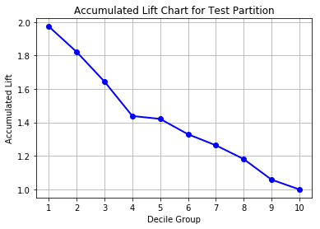
Accumulated Gain and Lift: Interpretation
If we only contact the top 20% of customers, then 48.43% of them will respond. This response rate is 1.82 times the overall rate.
If we only contact the top 30% of customers, then 43.72% of them will respond. This response rate is 1.64 times the overall rate.
Decile | Acc. Decile N | Acc. Decile % | Acc. Gain N | Acc. Gain % | Acc. Response % | Acc. Lift
1 | 263 | 9.07 | 138 | 17.90 | 52.47 | 1.97
2 | 479 | 16.52 | 232 | 30.09 | 48.43 | 1.82
3 | 693 | 23.90 | 303 | 39.30 | 43.72 | 1.64
4 | 1124 | 38.77 | 430 | 55.77 | 38.26 | 1.44
5 | 1254 | 43.26 | 474 | 61.48 | 37.80 | 1.42
6 | 1513 | 52.19 | 535 | 69.39 | 35.36 | 1.33
7 | 1830 | 63.13 | 615 | 79.77 | 33.61 | 1.26
8 | 2113 | 72.89 | 664 | 86.12 | 31.42 | 1.18
9 | 2554 | 88.10 | 719 | 93.26 | 28.15 | 1.06
10 | 2899 | 100.00 | 771 | 100.00 | 26.60 | 1.00
Overall | 2899 | 100.00 | 771 | 100.00 | 26.60 | 1

Slide 17
Gain and Lift: Goals
Gain %
Percent of Event category captured in entire data
Ideally, like to see decreasing Gain % down the deciles
Response %
Percent of Event category capture in a decile
Ideally, like to see decreasing Response % down the deciles
Lift
Compare Response % in a decile to that in entire data
Higher than one is always better

Slide 18
Gain and Lift: Decision Flow
Resources
Maximum percent of customers we can contact
Take Accumulated Decile k?
Starting from Accumulated Decile 1
Have resources to take this Accumulated Decile?
Good Enough Lift?
Subjectively decide if this Accumulated Lift is high enough?

Slide 19
Precision and Recall Curve: Motivation
I built a model to predict a customer’s likelihood to respond to my market campaign
I need a model that will predict YES to customers who are observed YES with high accuracy
Push the percent of True Positive up
Keep the percent of False Positive under control
I am not too concern about the accuracy of the predictions to the “NO” customers
Does not care about the True Negative

Slide 20
Precision and Recall Curve: Definitions
 | Predicted Non-Event | Predicted Event | Total Observed
Observed Non-Event | A (true negative) | B (false positive) | A + B
Observed Event | C (false negative) | D (true positive) | C + D
Total Predicted | A + C | B + D | A + B + C + D
Precision = (D / (B + D))
The fraction of True Positive observations out of the Predicted Event observations
Also known as Positive Predictive Value
The conditional probability Pr(Observed is Event | Predicted is Event)
Recall = (D / (C + D))
The fraction of True Positive observations out of the Observed Event observations
Same as the Sensitivity metric
The conditional probability Pr(Predicted is Event | Observed is Event)

Slide 21
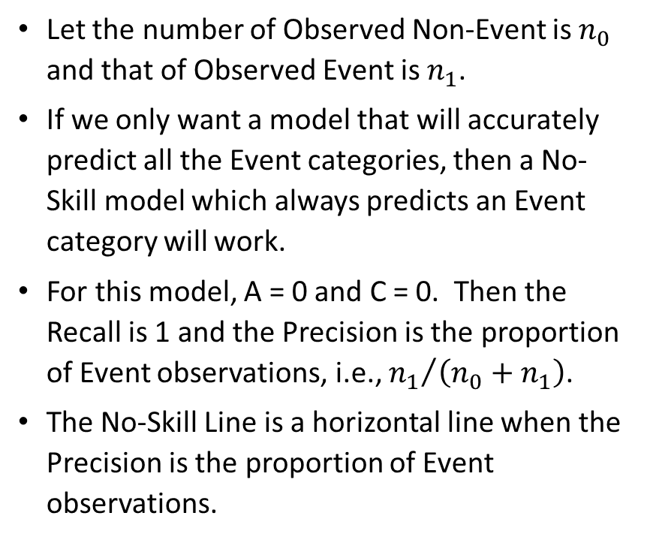
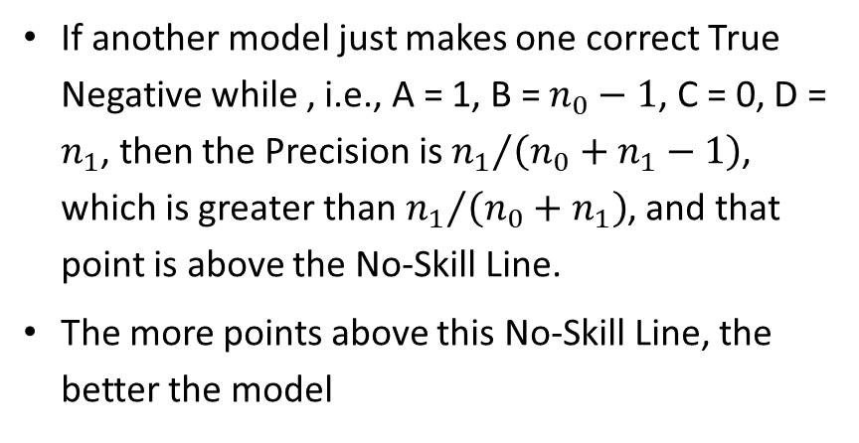
Precision and Recall Curve: No-Skill Line
Let the number of Observed Non-Event is $n_{0}$ and that of Observed Event is $n_{1}$.
If we only want a model that will accurately predict all the Event categories, then a No-Skill model which always predicts an Event category will work.
For this model, A = 0 and C = 0. Then the Recall is 1 and the Precision is the proportion of Event observations, i.e., ${n_{1}}/{\left(n_{0}+n_{1}\right)}$.
The No-Skill Line is a horizontal line when the Precision is the proportion of Event observations.
 | Predicted Non-Event | Predicted Event | Total Observed
Observed Non-Event | A (true negative) | B (false positive) | A + B
Observed Event | C (false negative) | D (true positive) | C + D
Total Predicted | A + C | B + D | A + B + C + D
If another model just makes one correct True Negative while , i.e., A = 1, B = $n_{0}−1$, C = 0, D = $n_{1}$, then the Precision is ${n_{1}}/{\left(n_{0}+n_{1}−1\right)}$, which is greater than ${n_{1}}/{\left(n_{0}+n_{1}\right)}$, and that point is above the No-Skill Line.
The more points above this No-Skill Line, the better the model

Slide 22
Precision and Recall Curve: Construction
Find Thresholds
Create a set of distinct values from the predicted event probabilities
Assign Event
Use each element of this set as a threshold to assign each observation into Predicted Event and Predicted Non-Event
Calculate Coordinates
Horizontal Axis: Sensitivity = (D / (C + D))
Assign an observation Predicted Event if Predicted Event Probability  Threshold
Vertical Axis: Precision = (D / (B + D))
 | Predicted Non-Event | Predicted Event | Total Observed
Observed Non-Event | A (true negative) | B (false positive) | A + B
Observed Event | C (false negative) | D (true positive) | C + D
Total Predicted | A + C | B + D | A + B + C + D

Slide 23
Precision and Recall Curve: Example
The set of distinct predicted event probabilities is: {0.2, 0.3, 0.4, 0.5, 0.7, 0.8, 0.9, 1.0}.
Number of Observed Event = 6
Number of Observed Non-Event = 5
The No-Skill Line is 6/(6+5) = 6/11 = 0.55
Observed Target Value | Predicted Event Probability
Event | 0.9
Non-Event | 0.5
Non-Event | 0.3
Event | 0.7
Event | 0.3
Non-Event | 0.8
Event | 0.4
Non-Event | 0.2
Event | 1.0
Event | 0.5
Non-Event | 0.3
Week 6 Evaluation.py

Slide 24
Precision and Recall Curve: Example
True Positive: Event
True Negative: Non-Event
Observed Target Value | Predicted Event Probability | Threshold: 0.2 | Threshold: 0.3 | Threshold: 0.4 | Threshold: 0.5 | Threshold: 0.7 | Threshold: 0.8 | Threshold: 0.9 | Threshold: 1.0
Non-Event | 0.2 | Event | Non-Event | Non-Event | Non-Event | Non-Event | Non-Event | Non-Event | Non-Event
Event | 0.3 | Event | Event | Non-Event | Non-Event | Non-Event | Non-Event | Non-Event | Non-Event
Non-Event | 0.3 | Event | Event | Non-Event | Non-Event | Non-Event | Non-Event | Non-Event | Non-Event
Non-Event | 0.3 | Event | Event | Non-Event | Non-Event | Non-Event | Non-Event | Non-Event | Non-Event
Event | 0.4 | Event | Event | Event | Non-Event | Non-Event | Non-Event | Non-Event | Non-Event
Event | 0.5 | Event | Event | Event | Event | Non-Event | Non-Event | Non-Event | Non-Event
Non-Event | 0.5 | Event | Event | Event | Event | Non-Event | Non-Event | Non-Event | Non-Event
Event | 0.7 | Event | Event | Event | Event | Event | Non-Event | Non-Event | Non-Event
Non-Event | 0.8 | Event | Event | Event | Event | Event | Event | Non-Event | Non-Event
Event | 0.9 | Event | Event | Event | Event | Event | Event | Event | Non-Event
Event | 1.0 | Event | Event | Event | Event | Event | Event | Event | Event
Threshold | 0.2 | 0.3 | 0.4 | 0.5 | 0.7 | 0.8 | 0.9 | 1
# TP | 6 | 6 | 5 | 4 | 3 | 2 | 2 | 1
# TN | 0 | 1 | 3 | 3 | 4 | 4 | 5 | 5
Precision | 6/11=0.55 | 6/10=0.60 | 5/7=0.71 | 4/6=0.67 | 3/4=0.75 | 2/3=0.67 | 2/2=1.00 | 1/1=1.00
Recall | 6/6=1.00 | 6/6=1.00 | 5/6=0.83 | 4/6=0.67 | 3/6=0.50 | 2/6=0.33 | 2/6=0.33 | 1/6=0.17

Slide 25
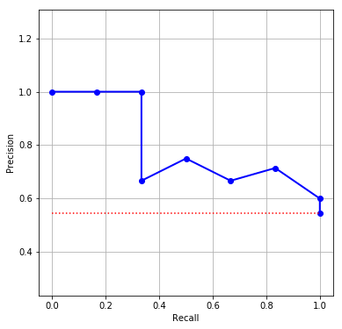
Precision and Recall Curve: Example
Threshold | 0.2 | 0.3 | 0.4 | 0.5 | 0.7 | 0.8 | 0.9 | 1
# TP | 6 | 6 | 5 | 4 | 3 | 2 | 2 | 1
# TN | 0 | 1 | 3 | 3 | 4 | 4 | 5 | 5
Precision | 0.55 | 0.60 | 0.71 | 0.67 | 0.75 | 0.67 | 1.00 | 1.00
Recall | 1.00 | 1.00 | 0.83 | 0.67 | 0.50 | 0.33 | 0.33 | 0.17
Note: Since the Precision and Recall routinely includes the point (0,1), you may need to add this point if they are not already there.
Finding: This model is good since all points, except the rightmost one, are above the No-Skill Line.

Slide 26
F1 Score
A perfect model will have Precision = 1 and Recall = 1.
We try to get the best Precision and the best Recall at the same time.
The F1 Score is the harmonic mean of Precision and Recall
Since the harmonic mean will substantially pull a large value down and push a small value up, a large F1 Score indicates that both Precision and Recall are relatively very large.
F1 Score = 1 / ((1 / Precision + 1 / Recall) / 2)
Plot the F1 Score (vertical axis) versus the Threshold (horizontal axis) to determine the optimal threshold that gives the best F1 Score.

Slide 27
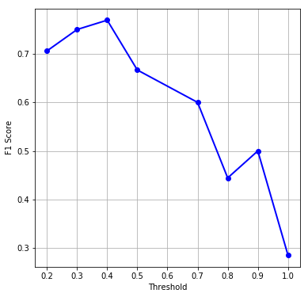
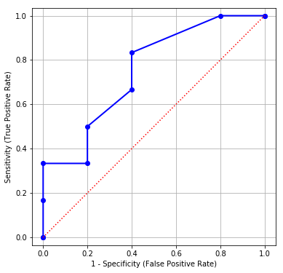
Precision and Recall Curve: Example
Threshold | 0.2 | 0.3 | 0.4 | 0.5 | 0.7 | 0.8 | 0.9 | 1
Precision | 0.55 | 0.60 | 0.71 | 0.67 | 0.75 | 0.67 | 1.00 | 1.00
Recall | 1.00 | 1.00 | 0.83 | 0.67 | 0.50 | 0.33 | 0.33 | 0.17
F1 Score | 0.71 | 0.75 | 0.77 | 0.67 | 0.60 | 0.44 | 0.50 | 0.29
Finding: The F1 Score attains its maximum when the threshold is 0.4.
For this threshold, the Sensitivity is 0.83 and the 1 – Specificity is 0.40.
The False Positive Rate is 40% and the True Positive Rate is 83%.

Slide 28
Classification Model: Rule-Based vs Parametric
Decision Tree is a Rule-Based Model
Predicted probabilities are based on ranges of predictors
Predicted probabilities change in steps whose sizes have no relationship to values of the predictors
Logistic Regression is a Parametric Model
Predicted probabilities are computed using formulas
Changes in probabilities are related to changes in predictor values

Slide 29
Logistic Regression Model
In a nutshell, a logistic model relates the probability that a target category will occur as a linear function of the predictors
Domain: $u∈ℝ$ (the real number line)
Domain: 𝑢∈ℝ (the real number line)
Range: $0≤f\left(u\right)≤1$
Range: 0≤𝑓(𝑢)≤1
Trend: when $u$ increases, so does $f\left(u\right)$
Trend: when 𝑢 increases, so does 𝑓(𝑢)
$$u=b_{0}+\sum_{i=1}^{k}{b_{i}x_{i}}$$
𝑢=𝑏_0+∑2_(𝑖=1)^𝑘▒〖𝑏_𝑖 𝑥_𝑖 〗
$Pr\left(Y=y\right)=f\left(u\right)$
Pr(𝑌=𝑦)=𝑓(𝑢)

Slide 30
Three Types of Logistic Model
Type of Logistic Model | Type of Target Variable | Example of Target Variable
Binary Logistic Model | Binary Categorical Two unique values | Loan Default: No Yes
Multinomial Logistic Model | Nominal Categorical Any number of unique values | US credit card network: American Express Discover MasterCard Visa
Ordinal Logistic Model | Ordinal Categorical Any number of unique values Explicit numerical, lexical, or contextual order among values | FICO score range: No Score Deep Subprime (< 620) Core Subprime (620 – 659) Prime (660-719) Superprime (≥ 720)

Slide 31
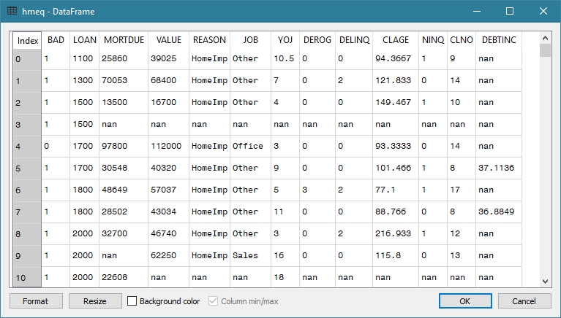
Multinomial Logistic (MNL): Data
Since BAD is 0 or 1, how can I observe the occurrence likelihood of a BAD loan?
What if I look at groups of observations by predictor values?

Slide 32
Multinomial Logistic (MNL): Strategy
Group the observations by values of the predictors for consideration
Count the occurrences (i.e., the frequencies) of the target categories in each group
Analyze how the predictor values influence the relative frequencies of the target categories

Slide 33
MNL: Subpopulation
Example
Home equity loan data: hmeq.csv.
BAD: Loan in default (0=No, 1=Yes), binary
REASON: Reason for getting the loan, (DebtCon=debt consolidation, HomeImp=home improvement), categorical
JOB: Job type (Mgr=manager, Office=office worker, Other, ProfExe=professional or executive, Sales, Self=self employed), categorical
DEROG: The number of derogatory inquiries (0+), interval
Target
Predictor

Slide 34
MNL: Subpopulation
Percent Table:
BAD 0 1 All
REASON
DebtCon 81.033605 18.966395 100.0
HomeImp 77.752809 22.247191 100.0
All 80.010512 19.989488 100.0
Group by REASON
REASON = DebtCon, the likelihood of BAD = 1 is 18.966395 / 19.989488 = 0.95 times of the overall
REASON = HomeImp, the likelihood of BAD = 1 is 22.247191 / 19.989488 = 1.11 times of the overall
Group by JOB
JOB = Office, the likelihood of BAD = 1 is 13.185654 / 20.524556 = 0.64 times of the overall
JOB = Self, the likelihood of BAD = 1 is 30.051813 / 20.524556 = 1.46 times of the overall
Question: Why the overall BAD=1 percents are different between REASON and JOB?
Percent Table:
BAD 0 1 All
JOB
Mgr 76.662321 23.337679 100.0
Office 86.814346 13.185654 100.0
Other 76.800670 23.199330 100.0
ProfExe 83.385580 16.614420 100.0
Sales 65.137615 34.862385 100.0
Self 69.948187 30.051813 100.0
All 79.475444 20.524556 100.0

Slide 35
MNL: Subpopulation
Group by REASON and JOB
REASON = HomeImp and JOB = Office, the likelihood of BAD = 1 is 10.963455 / 20.375723 = 0.54 of the overall
REASON = DebtCon and JOB = Mgr or Other, the likelihood of BAD = 1 is practically the same as the overall
REASON = DebtCon and JOB = Self, the likelihood of BAD = 1 is 43.835616 / 20.375723 = 2.2 times of the overall
Percent Table:
BAD 0 1 All
REASON JOB
DebtCon Mgr 79.720280 20.279720 100.0
Office 85.161290 14.838710 100.0
Other 79.239401 20.760599 100.0
ProfExe 84.769776 15.230224 100.0
Sales 64.948454 35.051546 100.0
Self 56.164384 43.835616 100.0
HomeImp Mgr 67.816092 32.183908 100.0
Office 89.036545 10.963455 100.0
Other 71.368715 28.631285 100.0
ProfExe 81.975309 18.024691 100.0
Sales 66.666667 33.333333 100.0
Self 81.739130 18.260870 100.0
All 79.624277 20.375723 100.0

Slide 36
MNL: Subpopulation
Percent Table:
BAD 0 1 All
REASON JOB DEROG
DebtCon Mgr 0.0 82.425743 17.574257 100.0
1.0 68.965517 31.034483 100.0
2.0 40.909091 59.090909 100.0
3.0 0.000000 100.000000 100.0
4.0 0.000000 100.000000 100.0
7.0 0.000000 100.000000 100.0
8.0 0.000000 100.000000 100.0
Office 0.0 88.376754 11.623246 100.0
1.0 50.000000 50.000000 100.0
2.0 46.666667 53.333333 100.0
3.0 0.000000 100.000000 100.0
Other 0.0 81.712386 18.287614 100.0
1.0 57.692308 42.307692 100.0
2.0 65.957447 34.042553 100.0
3.0 50.000000 50.000000 100.0
4.0 71.428571 28.571429 100.0
5.0 100.000000 0.000000 100.0
6.0 62.500000 37.500000 100.0
7.0 0.000000 100.000000 100.0
8.0 0.000000 100.000000 100.0
9.0 0.000000 100.000000 100.0
10.0 0.000000 100.000000 100.0
ProfExe 0.0 87.352941 12.647059 100.0
1.0 76.923077 23.076923 100.0
2.0 37.500000 62.500000 100.0
3.0 22.222222 77.777778 100.0
4.0 0.000000 100.000000 100.0
6.0 0.000000 100.000000 100.0
7.0 0.000000 100.000000 100.0
Sales 0.0 72.000000 28.000000 100.0
... ... ...
All 78.939972 21.060028 100.0
What about the interval predictors?
Even though DEROG is an interval variable, we will treat it as a categorical variable only for the purpose of aggregation.

Slide 37
MNL: Subpopulation
Subpopulations are defined by the observed cross-classifications of distinct values of predictors (i.e., input features).
For example, if REASON (categorical), JOB (categorical), DEROG (interval) are predictors, then examples of subpopulations are:
Reason = DebtCon, JOB = Mgr, and DEROG=0
REASON = DebtCon, JOB = ProfExe, and DEROG=6
REASON = HomeImp, JOB = Office, DEROG=2
Subpopulations are user-defined disjoint partitions of the data

Slide 38
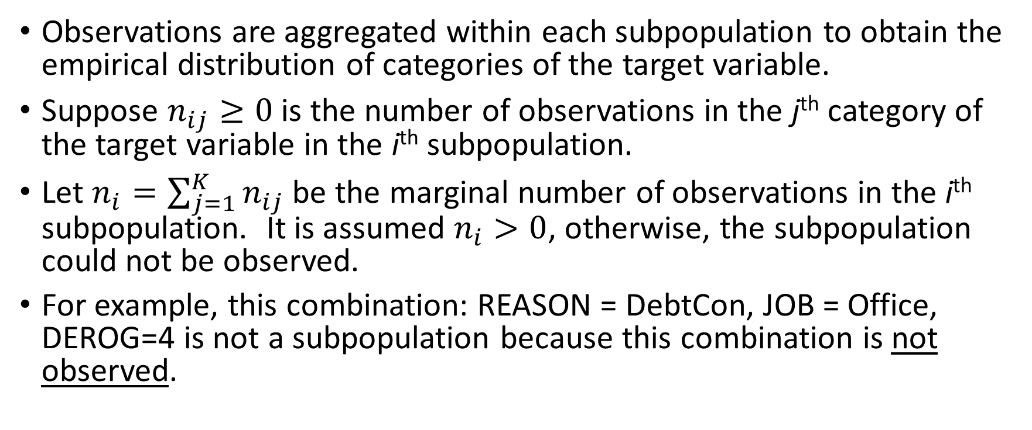
MNL: Subpopulation
Observations are aggregated within each subpopulation to obtain the empirical distribution of categories of the target variable.
Suppose $n_{ij}≥0$ is the number of observations in the j^{th} category of the target variable in the i^{th} subpopulation.
Let $n_{i}=\sum_{j=1}^{K}{n_{ij}}$ be the marginal number of observations in the i^{th} subpopulation. It is assumed $n_{i}>0$, otherwise, the subpopulation could not be observed.
For example, this combination: REASON = DebtCon, JOB = Office, DEROG=4 is not a subpopulation because this combination is not observed.

Slide 39
MNL: Parameter Coding for Categorical Predictor
The dummy coding (a.k.a. GLM or over-parametrized coding) is to create a binary column whose values are: 0 or 1 for each category of a categorical predictor.
The pandas.get_dummies() function can generate dummy columns
MNL does not distinguish between nominal and ordinal predictors, both types are considered as categorical predictors.
If the categorical predictor has p categories, then p binary dummy columns are created.

Slide 40
MNL: Parameter Coding for Categorical Predictor
REASON has two categories. The two binary columns are:
REASON_Debtcon = 1 if REASON = ‘DebtCon’, 0 otherwise
REASON_HomeImp = 1 if REASON = ‘HomeImp’, 0 otherwise.
JOB has six categories. The six binary columns are:
JOB_Mgr = 1 if JOB = ‘Mgr’, 0 otherwise
JOB_Office = 1 if JOB = ‘Office’, 0 otherwise
JOB_Other = 1 if JOB = ‘Other’, 0 otherwise
JOB_ProfExe = 1 if JOB = ‘ProfExe’, 0 otherwise
JOB_Sales = 1 if JOB = ‘Sales’, 0 otherwise
JOB_Self = 1 if JOB = ‘Self’, 0 otherwise

Slide 41
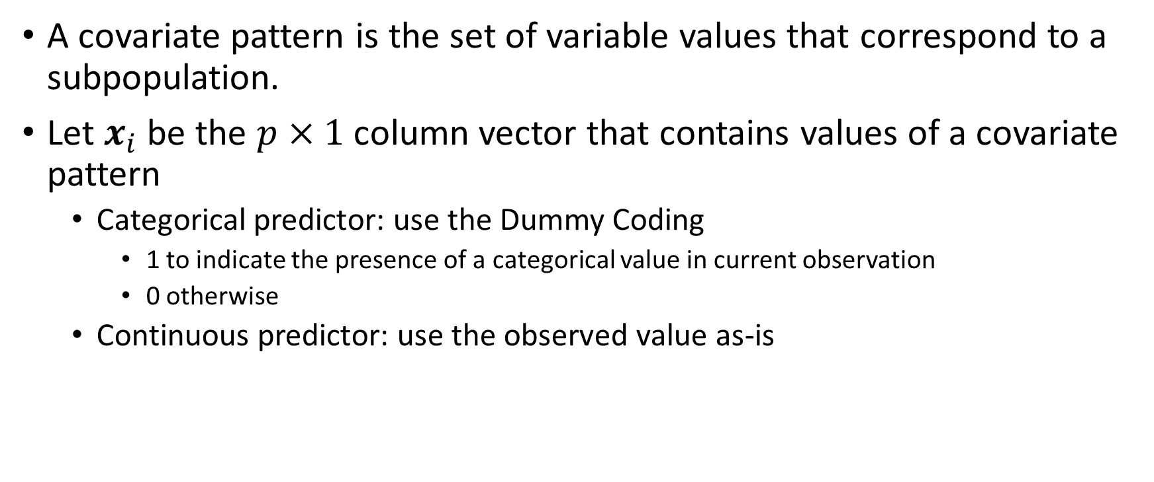
MNL: Covariate Pattern
A covariate pattern is the set of variable values that correspond to a subpopulation.
Let $x_{i}$ be the $p×1$ column vector that contains values of a covariate pattern
Categorical predictor: use the Dummy Coding
1 to indicate the presence of a categorical value in current observation
0 otherwise
Continuous predictor: use the observed value as-is

Slide 42
MNL: Covariate Pattern
Subpopulation
Covariate Pattern
REASON | JOB | DEROG
DebtCon | Mgr | 0
REASON | JOB | DEROG
HomeImp | ProfExe | 6
REASON_DebtCon | REASON_HomeImp | JOB_Mgr | JOB_Office | JOB_Other | JOB_ProfExe | JOB_Sales | JOB_Self | DEROG
1 | 0 | 1 | 0 | 0 | 0 | 0 | 0 | 0
REASON_DebtCon | REASON_HomeImp | JOB_Mgr | JOB_Office | JOB_Other | JOB_ProfExe | JOB_Sales | JOB_Self | DEROG
0 | 1 | 0 | 0 | 0 | 1 | 0 | 0 | 6

Slide 43
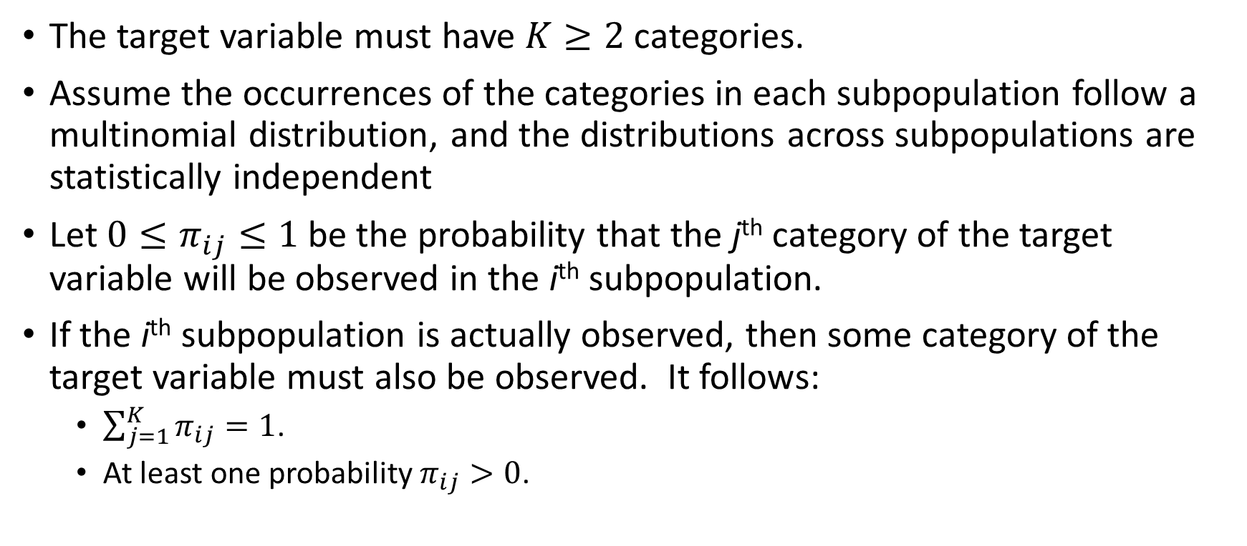
MNL: Target Variable
The target variable must have $K≥2$ categories.
Assume the occurrences of the categories in each subpopulation follow a multinomial distribution, and the distributions across subpopulations are statistically independent
Let ${0≤π}_{ij}≤1$ be the probability that the j^{th} category of the target variable will be observed in the i^{th} subpopulation.
If the i^{th} subpopulation is actually observed, then some category of the target variable must also be observed. It follows:
$\sum_{j=1}^{K}{π_{ij}}=1$.
At least one probability $π_{ij}>0$.

Slide 44
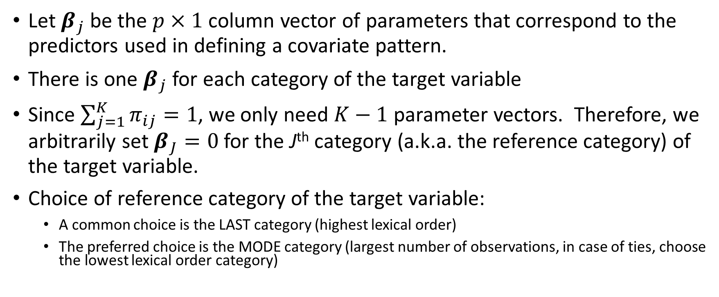
MNL: Parameter
Let $β_{j}$ be the $p×1$ column vector of parameters that correspond to the predictors used in defining a covariate pattern.
There is one $β_{j}$ for each category of the target variable
Since $\sum_{j=1}^{K}{π_{ij}}=1$, we only need $K−1$ parameter vectors. Therefore, we arbitrarily set $β_{J}=0$ for the J^{th} category (a.k.a. the reference category) of the target variable.
Choice of reference category of the target variable:
A common choice is the LAST category (highest lexical order)
The preferred choice is the MODE category (largest number of observations, in case of ties, choose the lowest lexical order category)

Slide 45
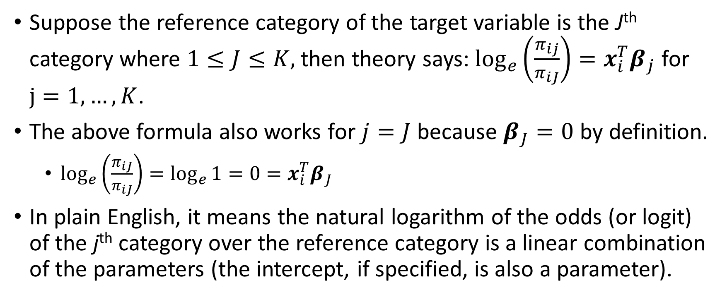
MNL: Theory
Suppose the reference category of the target variable is the J^{th} category where $1≤J≤K,$then theory says: $\log_{e}\left(\frac{π_{ij}}{π_{iJ}}\right)={x_{i}^{T}β}_{j}$ for $j=1, …,K$.
The above formula also works for $j=J$ because $β_{J}=0$ by definition.
$\log_{e}\left(\frac{π_{iJ}}{π_{iJ}}\right)=\log_{e}{1}=0={x_{i}^{T}β}_{J}$
In plain English, it means the natural logarithm of the odds (or logit) of the j^{th} category over the reference category is a linear combination of the parameters (the intercept, if specified, is also a parameter).

Slide 46
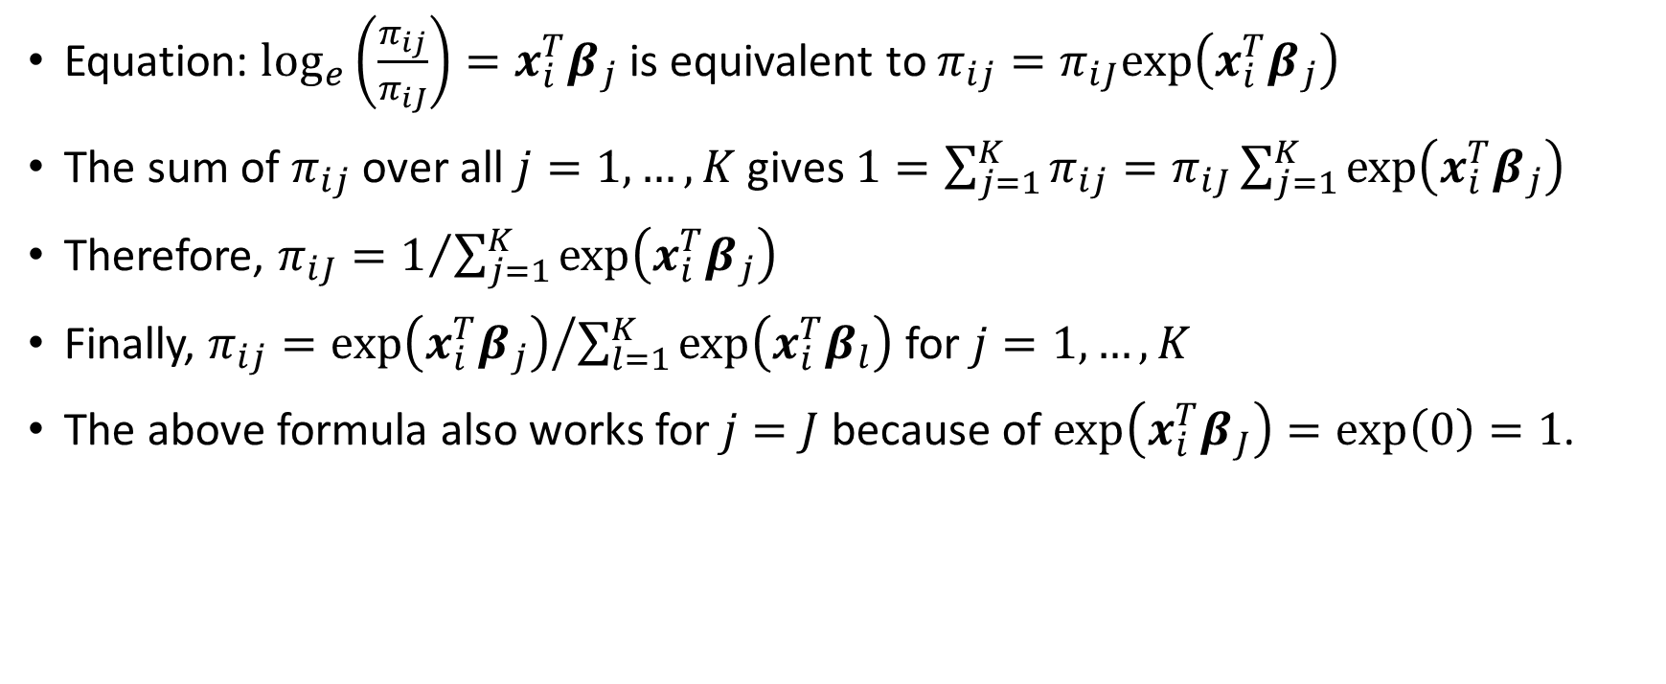
MNL: Theory
Equation: $\log_{e}\left(\frac{π_{ij}}{π_{iJ}}\right)={x_{i}^{T}β}_{j}$ is equivalent to $π_{ij}=π_{iJ}exp⁡\left({x_{i}^{T}β}_{j}\right)$
The sum of $π_{ij}$ over all $j=1,…,K$ gives $1=\sum_{j=1}^{K}{π_{ij}}=π_{iJ}\sum_{j=1}^{K}{exp⁡\left({x_{i}^{T}β}_{j}\right)}$
Therefore, $π_{iJ}=1/{\sum_{j=1}^{K}{exp⁡\left({x_{i}^{T}β}_{j}\right)}}$
Finally, $π_{ij}={exp⁡\left({x_{i}^{T}β}_{j}\right)}/{\sum_{l=1}^{K}{exp⁡\left({x_{i}^{T}β}_{l}\right)}}$ for $j=1,…,K$
The above formula also works for $j=J$ because of $\exp\left({x_{i}^{T}β}_{J}\right)=exp⁡\left(0\right)=1$.

Slide 47
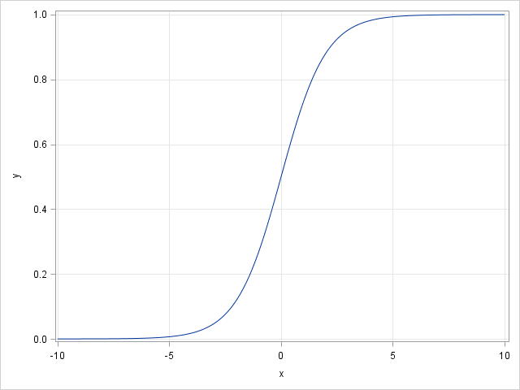
MNL: Why Logistic?
The logistic curve has the formula: $y=\frac{1}{1+e^{−x}}=\frac{e^{x}}{1+e^{x}}$ for any real x.
The range: $0≤y≤1$ for all values of $x$
It has two horizontal asymptotes:
$y=0$ as $x→−∞$ and
$y=1$ as $x→+∞$
In the middle portion of the domain, the curve appears fairly linear in x
Therefore, the curve is suitable for representing probability.

Slide 48
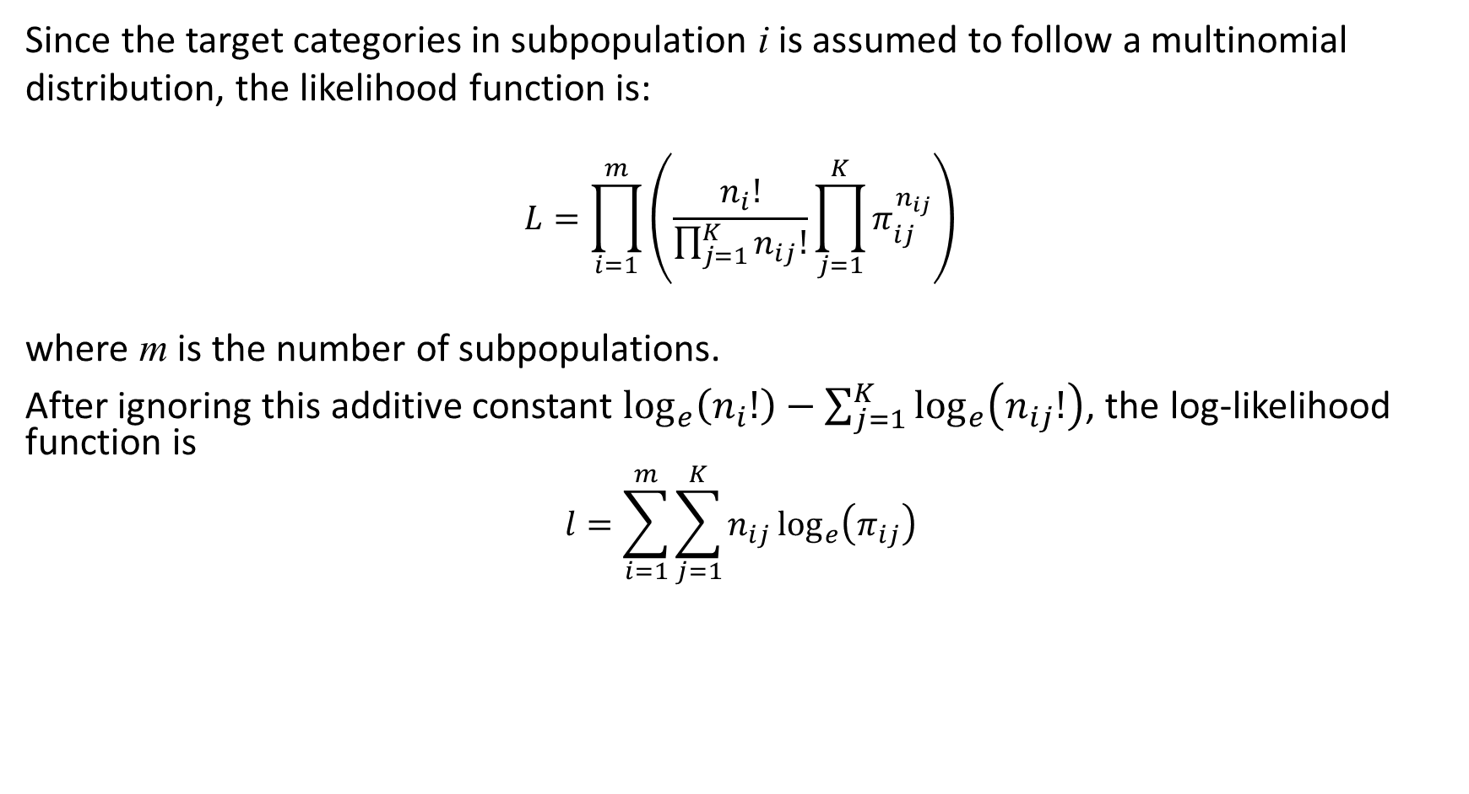
MNL: Maximum Likelihood Estimation (MLE)
Since the target categories in subpopulation i is assumed to follow a multinomial distribution, the likelihood function is: $$L=\prod_{i=1}^{m}{\left(\frac{n_{i}!}{\prod_{j=1}^{K}{n_{ij}!}}\prod_{j=1}^{K}{π_{ij}^{n_{ij}}}\right)}$$ where m is the number of subpopulations.
After ignoring this additive constant $\log_{e}\left(n_{i}!\right)−\sum_{j=1}^{K}{\log_{e}\left(n_{ij}!\right)}$, the log-likelihood function is $$l=\sum_{i=1}^{m}{\sum_{j=1}^{K}{n_{ij}\log_{e}\left(π_{ij}\right)}}$$

Slide 49
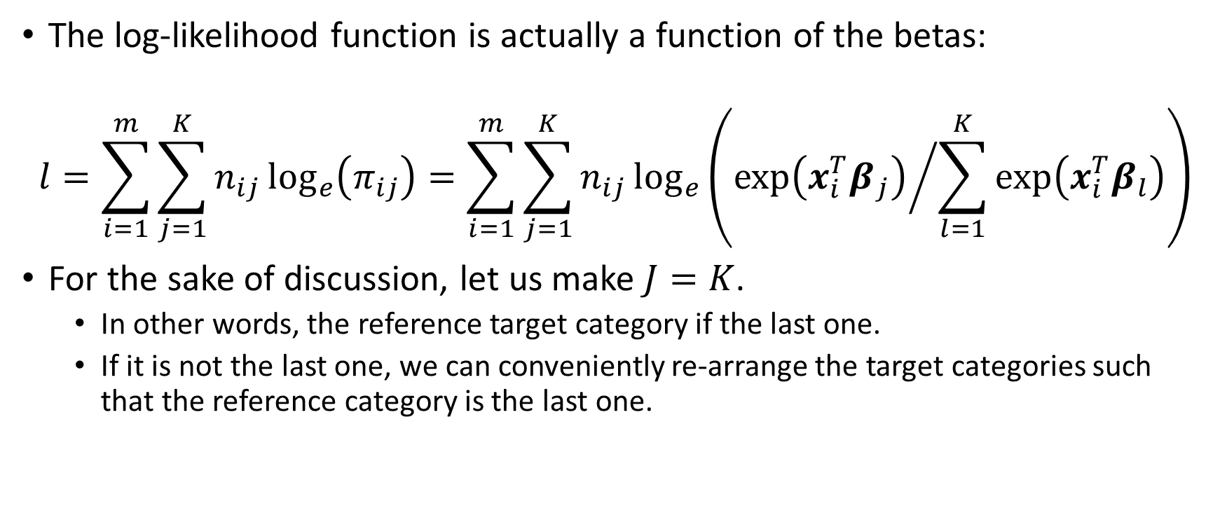
MNL: The Log-Likelihood Function
The log-likelihood function is actually a function of the betas:
$$l=\sum_{i=1}^{m}{\sum_{j=1}^{K}{n_{ij}\log_{e}\left(π_{ij}\right)}}=\sum_{i=1}^{m}{\sum_{j=1}^{K}{n_{ij}\log_{e}\left({exp⁡\left({x_{i}^{T}β}_{j}\right)}/{\sum_{l=1}^{K}{exp⁡\left({x_{i}^{T}β}_{l}\right)}}\right)}}$$
For the sake of discussion, let us make $J=K$.
In other words, the reference target category if the last one.
If it is not the last one, we can conveniently re-arrange the target categories such that the reference category is the last one.

Slide 50
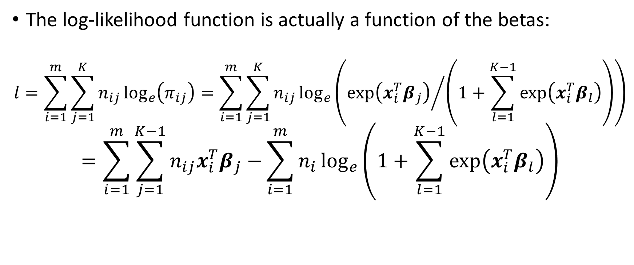
MNL: The Log-Likelihood Function
The log-likelihood function is actually a function of the betas:
$$l=\sum_{i=1}^{m}{\sum_{j=1}^{K}{n_{ij}\log_{e}\left(π_{ij}\right)}}=\sum_{i=1}^{m}{\sum_{j=1}^{K}{n_{ij}\log_{e}\left({exp⁡\left({x_{i}^{T}β}_{j}\right)}/{\left(1+\sum_{l=1}^{K−1}{exp⁡\left({x_{i}^{T}β}_{l}\right)}\right)}\right)}}$$
$$=\sum_{i=1}^{m}{\sum_{j=1}^{K−1}{n_{ij}{x_{i}^{T}β}_{j}−}\sum_{i=1}^{m}{n_{i}\log_{e}\left(1+\sum_{l=1}^{K−1}{exp⁡\left({x_{i}^{T}β}_{l}\right)}\right)}}$$

Slide 51
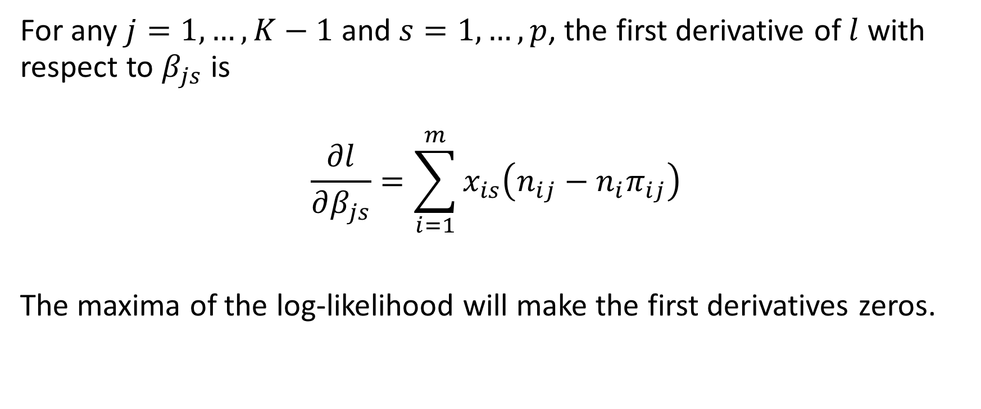
MNL: First Derivative of the Log-Likelihood Function
For any $j=1,…,K−1$ and $s=1,…,p$, the first derivative of $l$ with respect to $β_{js}$ is
$$\frac{∂l}{∂β_{js}}=\sum_{i=1}^{m}{x_{is}\left(n_{ij}−{n_{i}π}_{ij}\right)}$$
The maxima of the log-likelihood will make the first derivatives zeros.

Slide 52
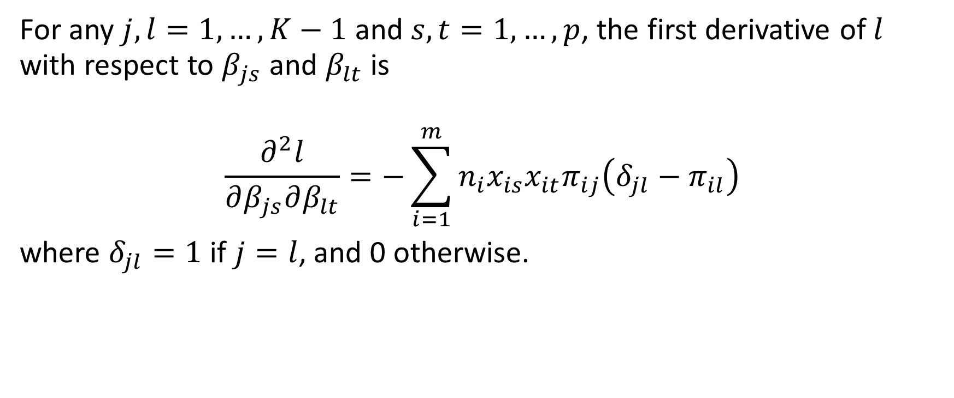
MNL: Second Derivative of the Log-Likelihood Function
For any $j,l=1,…,K−1$ and $s,t=1,…,p$, the first derivative of $l$ with respect to $β_{js}$ and $β_{lt}$ is
$$\frac{∂^{2}l}{∂β_{js}∂β_{lt}}=−\sum_{i=1}^{m}{{n_{i}x}_{is}x_{it}π_{ij}\left(δ_{jl}−π_{il}\right)}$$
where $δ_{jl}=1$ if $j=l$, and 0 otherwise.
See the Machine Learning book for details

Slide 53
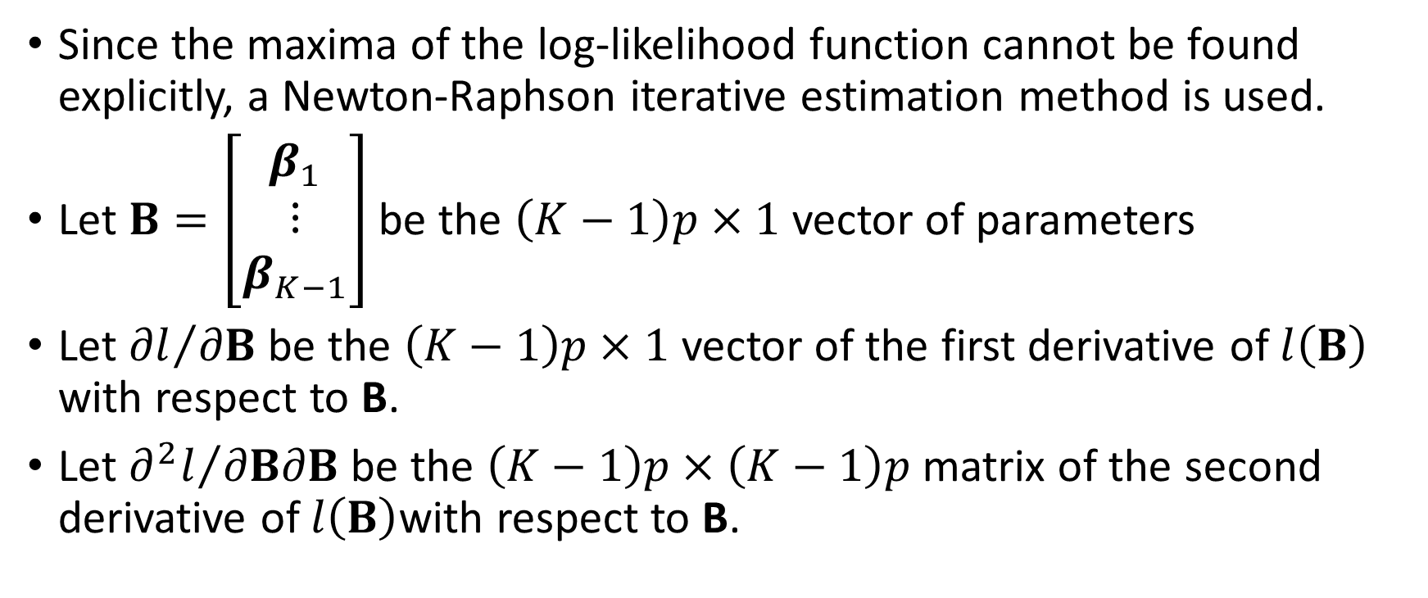
MNL: Newton-Raphson Algorithm
Since the maxima of the log-likelihood function cannot be found explicitly, a Newton-Raphson iterative estimation method is used.
Let $B=\left[\begin{matrix}β_{1} \\ ⋮ \\ β_{K−1}\end{matrix}\right]$ be the $\left(K−1\right)p×1$ vector of parameters
Let ${∂l}/{∂B}$ be the $\left(K−1\right)p×1$ vector of the first derivative of $l\left(B\right)$ with respect to B.
Let ${∂^{2}l}/{∂B∂B}$ be the $\left(K−1\right)p×\left(K−1\right)p$ matrix of the second derivative of $l\left(B\right)$with respect to B.

Slide 54
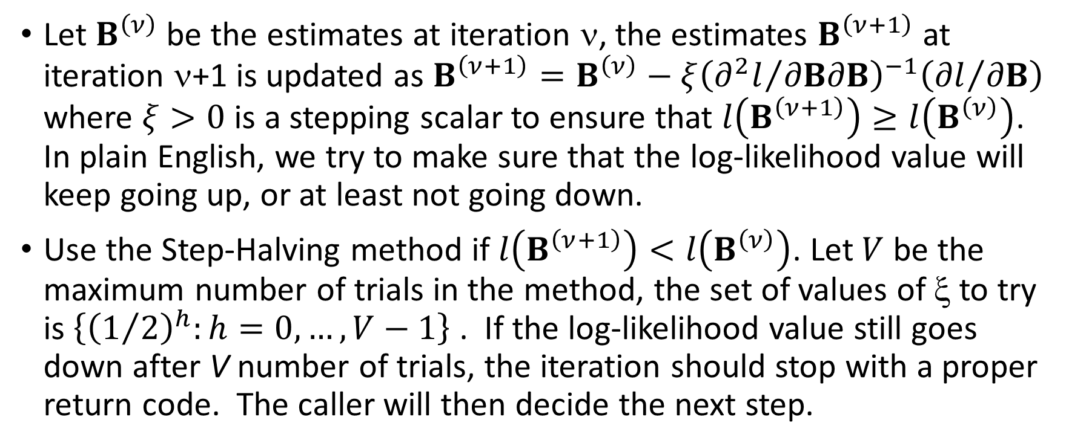
MNL: Newton-Raphson Algorithm
Let $B^{\left(ν\right)}$ be the estimates at iteration ν, the estimates $B^{\left(ν+1\right)}$ at iteration ν+1 is updated as $B^{\left(ν+1\right)}=B^{\left(ν\right)}−ξ{\left({∂^{2}l}/{∂B∂B}\right)}^{−1}\left({∂l}/{∂B}\right)$ where $ξ>0$ is a stepping scalar to ensure that $l\left(B^{\left(ν+1\right)}\right)≥l\left(B^{\left(ν\right)}\right)$. In plain English, we try to make sure that the log-likelihood value will keep going up, or at least not going down.
Use the Step-Halving method if $l\left(B^{\left(ν+1\right)}\right)<l\left(B^{\left(ν\right)}\right)$. Let $V$ be the maximum number of trials in the method, the set of values of ξ to try is $\left\{{\left(1/2\right)}^{h}:h=0,…,V−1\right\}$ . If the log-likelihood value still goes down after V number of trials, the iteration should stop with a proper return code. The caller will then decide the next step.

Slide 55
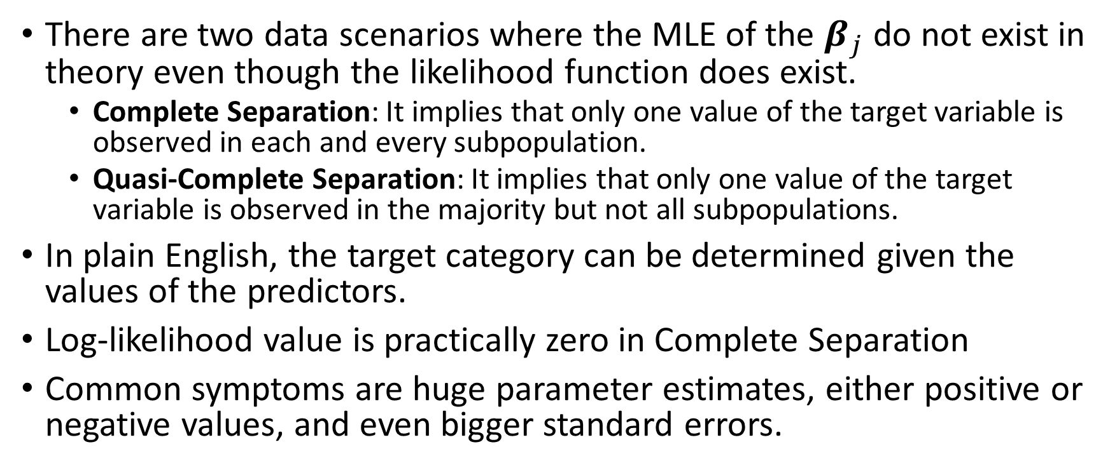
MNL: Separation
There are two data scenarios where the MLE of the $β_{j}$ do not exist in theory even though the likelihood function does exist.
Complete Separation: It implies that only one value of the target variable is observed in each and every subpopulation.
Quasi-Complete Separation: It implies that only one value of the target variable is observed in the majority but not all subpopulations.
In plain English, the target category can be determined given the values of the predictors.
Log-likelihood value is practically zero in Complete Separation
Common symptoms are huge parameter estimates, either positive or negative values, and even bigger standard errors.

Slide 56
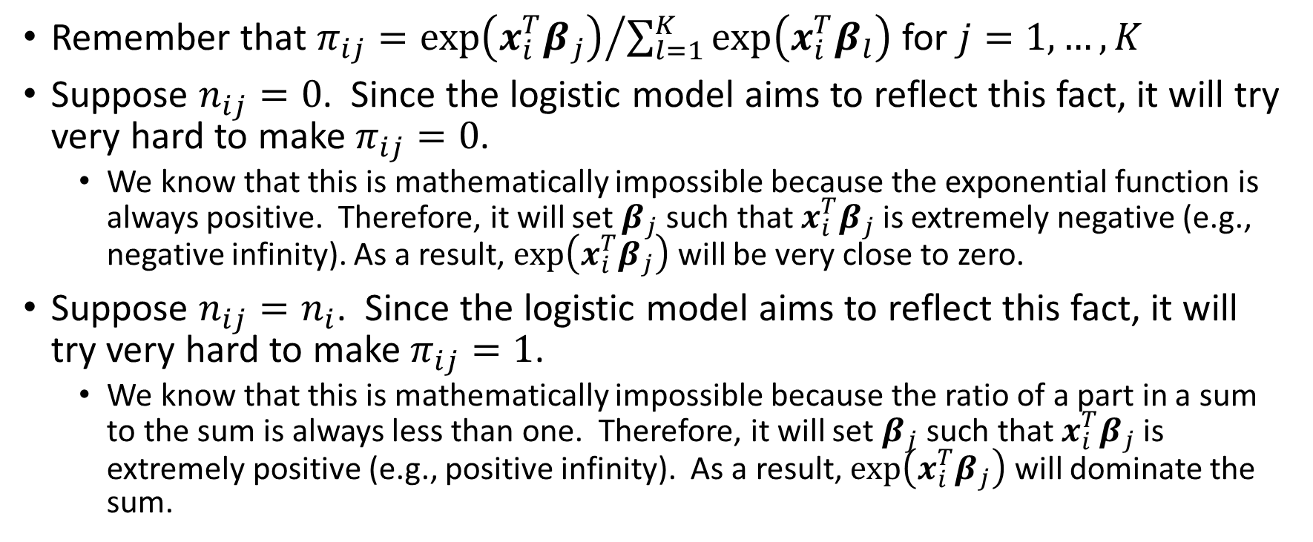
MNL: Mathematics on Separation
Remember that $π_{ij}={exp⁡\left({x_{i}^{T}β}_{j}\right)}/{\sum_{l=1}^{K}{exp⁡\left({x_{i}^{T}β}_{l}\right)}}$ for $j=1,…,K$
Suppose $n_{ij}=0$. Since the logistic model aims to reflect this fact, it will try very hard to make $π_{ij}=0$.
We know that this is mathematically impossible because the exponential function is always positive. Therefore, it will set $β_{j}$ such that ${x_{i}^{T}β}_{j}$ is extremely negative (e.g., negative infinity). As a result, $exp⁡\left({x_{i}^{T}β}_{j}\right)$ will be very close to zero.
Suppose $n_{ij}=n_{i}$. Since the logistic model aims to reflect this fact, it will try very hard to make $π_{ij}=1$.
We know that this is mathematically impossible because the ratio of a part in a sum to the sum is always less than one. Therefore, it will set $β_{j}$ such that ${x_{i}^{T}β}_{j}$ is extremely positive (e.g., positive infinity). As a result, $exp⁡\left({x_{i}^{T}β}_{j}\right)$ will dominate the sum.

Slide 57
MNL: Why Separation Occurs?
Used nominal predictors which have too many unique values
e.g., the Case ID, the SSN, the Employee ID
Inappropriately specified interval predictors as categorical
Included too many predictors, but not enough observations
Too many predictors → every observation produces a unique covariate pattern → only one target value is observed in the covariate pattern

Slide 58
MNL: Workarounds for Separation
Use fewer predictors, avoid interval predictors.
Consider pre-binning interval predictors and use the resulting Bin IDs as categorical predictors instead.
Use a penalized log-likelihood function with a penalty on the sum of the absolute (or squares of) parameter estimates.

Slide 59
MNL: Select Predictors
Forward Selection
Enter predictor into the model one at a time
Test if adding the predictor will improve the model goodness-of-fit
Backward Selection
Remove predictor from the model one at a time
Test if removing the predictor will not reduce the model goodness-of-fit
Start with a model without any predictor
Start with a model with ALL the predictors

Slide 60
MNL: Nested Models
Model 1
Model 0
Model 0 is nested in Model 1
Predictors in Model 0 are also predictors in Model 1
Model 1 should have better goodness-of-fit than Model 0
If Model 1 has the “same” goodness-of-fit as Model 0, then the predictors in Model 1 which are NOT in Model 0 do not help make Model 1 better.

Slide 61
MNL: Nested Models
Model 1
Model 0
1. Model 1
2. Model 0
1. Model 0
2. Model 1

Slide 62
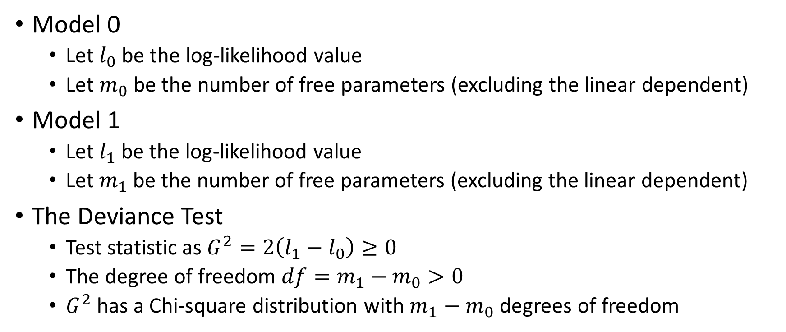
MNL: Deviance Test
Model 0
Let $l_{0}$ be the log-likelihood value
Let $m_{0}$ be the number of free parameters (excluding the linear dependent)
Model 1
Let $l_{1}$ be the log-likelihood value
Let $m_{1}$ be the number of free parameters (excluding the linear dependent)
The Deviance Test
Test statistic as $G^{2}=2\left(l_{1}−l_{0}\right)≥0$
The degree of freedom $df=m_{1}−m_{0}>0$
$G^{2}$ has a Chi-square distribution with $m_{1}−m_{0}$ degrees of freedom

Slide 63
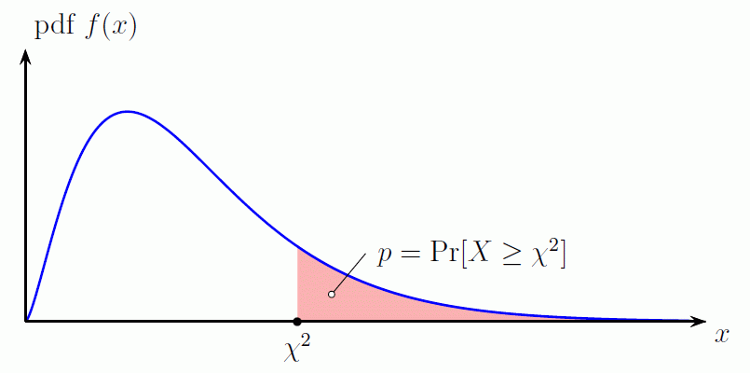
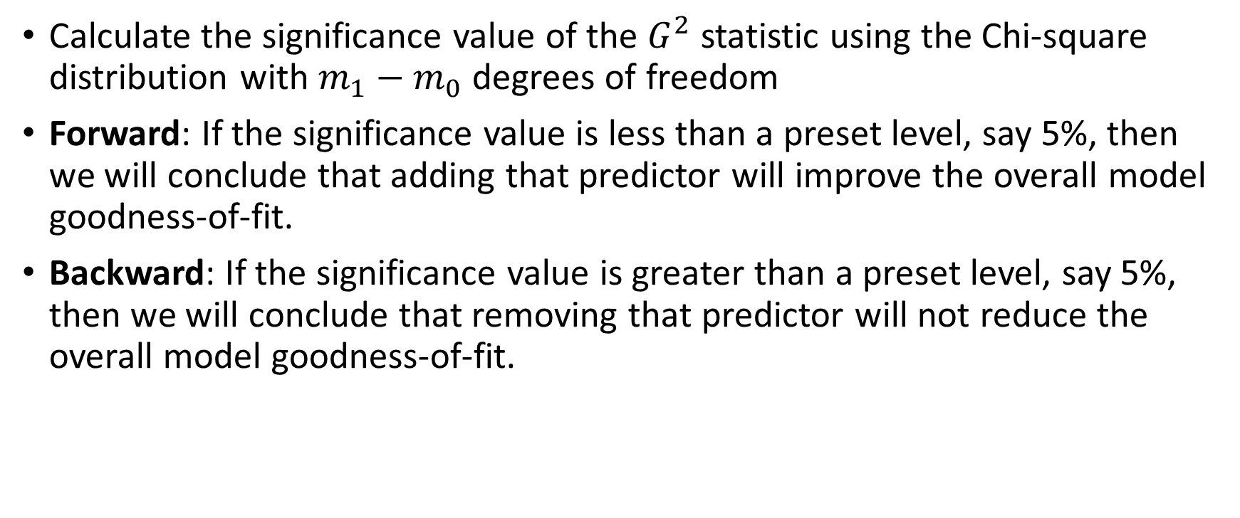
MNL: Deviance Test
Calculate the significance value of the $G^{2}$ statistic using the Chi-square distribution with $m_{1}−m_{0}$ degrees of freedom
Forward: If the significance value is less than a preset level, say 5%, then we will conclude that adding that predictor will improve the overall model goodness-of-fit.
Backward: If the significance value is greater than a preset level, say 5%, then we will conclude that removing that predictor will not reduce the overall model goodness-of-fit.

Slide 64
MNL: Deviance Test Decision
Forward Selection
Consider only predictors whose significances are less than 5%
Enter the predictor which has the lowest significance value into the current model
Backward Selection
Consider only predictors whose significances are greater than 5%
Remove the predictor which has the highest significance value from the current model

Slide 65
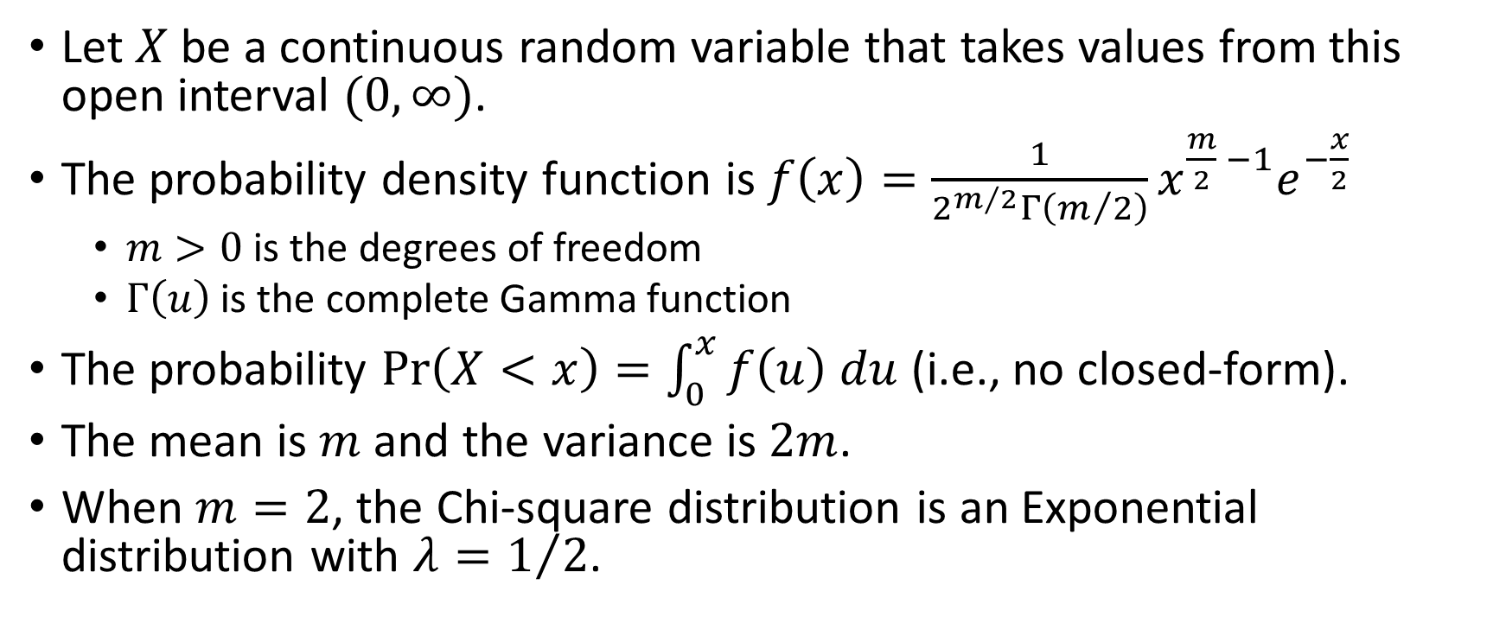
Chi-Square Distribution
Let $X$ be a continuous random variable that takes values from this open interval $(0,∞)$.
The probability density function is $f\left(x\right)=\frac{1}{2^{m/2}Γ\left(m/2\right)}x^{\frac{m}{2} −1}e^{−\frac{x}{2}}$
$m>0$ is the degrees of freedom
$Γ\left(u\right)$ is the complete Gamma function
The probability $Pr\left(X<x\right)=\int_{0}^{x}{f\left(u\right) du}$ (i.e., no closed-form).
The mean is $m$ and the variance is $2m$.
When $m=2$, the Chi-square distribution is an Exponential distribution with $λ=1/2$.

Slide 66
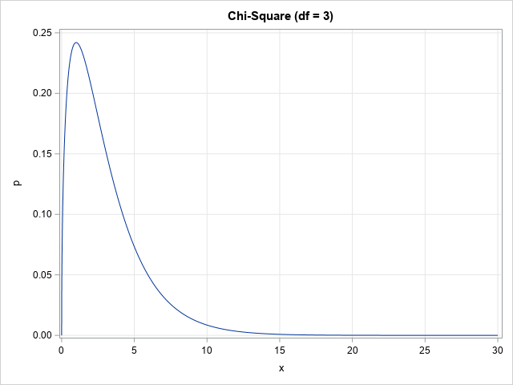
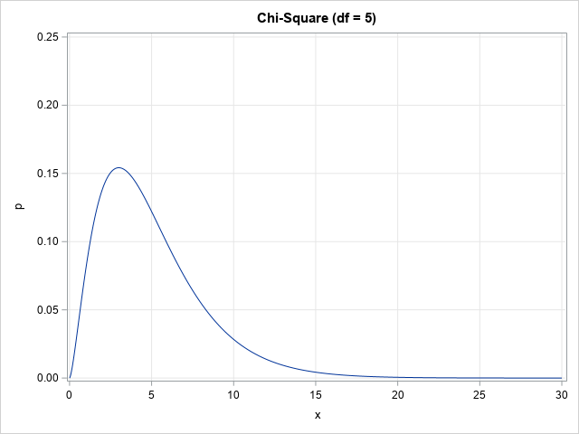
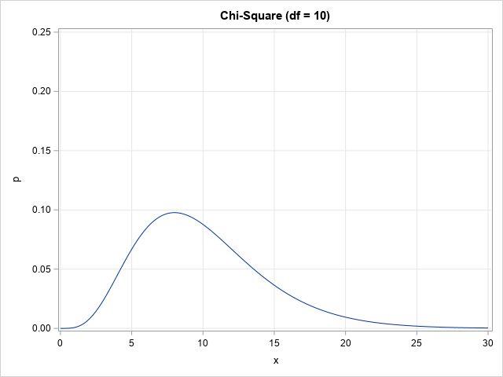
Chi-Square Distribution
Python Function | Density | Distribution | Significance | Quantile | Random Number
scipy.stats.chi2 | .pdf() | .cdf() | .sf() | .ppf() | .rvs()

Slide 67
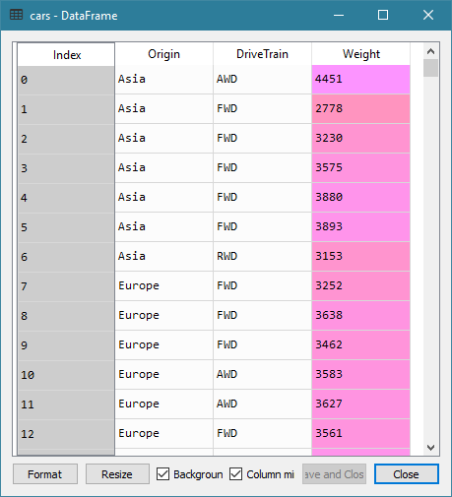
MNL: 2014 Cars Data
Data
2014 Cars Data: cars.csv.
428 observations
Origin: Manufacturer Origin, nominal
DriveTrain: Type of Drive Train, (AWD, FWD, RWD), categorical
Weight: Vehicle Weight, interval
Target
Predictor

Slide 68
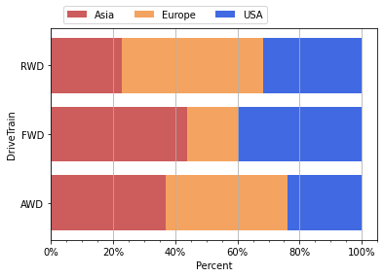
MNL: 2014 Cars Data
Week 7 Cars Logistic Forward Selection.py
RWD vehicles are made more often by European car manufacturers than Asian and USA car manufacturers
FWD vehicles are made more often by Asian and USA car manufacturers than European car manufacturer
AWD vehicles are made equally often by Asian and European car manufacturers

Slide 69
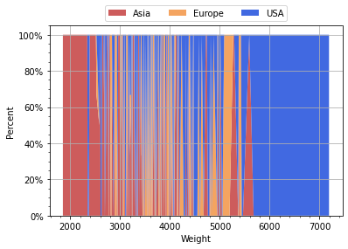
MNL: 2014 Cars Data
Week 7 Cars Logistic Forward Selection.py
If a vehicle’s weight is above 5,800 pounds, then the car manufacturer must be in USA
If a vehicle’s weight is less than 2,200 pounds, then the car manufacturer must be in Asia.

Slide 70
MNL: Forward Selection
Week 7 Cars Logistic Forward Selection.py
Model 0: Origin = Intercept
In other words, it is the Intercept Only model
Consider Model 1: Origin = Intercept + <predictor> <predictor> = DriveTrain, Weight
Calculate the Deviance test statistic and then use the Chi-square significance value to determine if the <predictor> will improve model goodness-of-fit

Slide 71
SWEEP Operator
def SWEEPOperator (pDim, inputM, tol):
# pDim: dimension of matrix inputM, integer greater than one
# inputM: a square and symmetric matrix, numpy array
# tol: singularity tolerance, positive real
aliasParam = []
nonAliasParam = []
A = numpy.copy(inputM)
diagA = numpy.diagonal(inputM)
for k in range(pDim):
Akk = A[k,k]
if (Akk >= (tol * diagA[k])):
nonAliasParam.append(k)
ANext = A - numpy.outer(A[:, k], A[k, :]) / Akk
ANext[:, k] = A[:, k] / Akk
ANext[k, :] = ANext[:, k]
ANext[k, k] = -1.0 / Akk
else:
aliasParam.append(k)
ANext[:, k] = 0.0 * A[:, k]
ANext[k, :] = ANext[:, k]
A = ANext
return (A, aliasParam, nonAliasParam)
Week 7 Cars Logistic Forward Selection.py

Slide 72
Train Model Function
def build_mnlogit (fullX, y):
# Find the non-redundant columns in the design matrix fullX
nFullParam = fullX.shape[1]
XtX = numpy.transpose(fullX).dot(fullX)
invXtX, aliasParam, nonAliasParam
= SWEEPOperator(pDim = nFullParam, inputM = XtX, tol = 1e-7)
# Build a multinomial logistic model
X = fullX.iloc[:, list(nonAliasParam)]
logit = stats.MNLogit(y, X)
thisFit = logit.fit(method = 'newton', maxiter = 1000, gtol = 1e-6,
full_output = True, disp = True)
thisParameter = thisFit.params
thisLLK = logit.loglike(thisParameter.values)
# The number of free parameters
nYCat = thisFit.J
thisDF = len(nonAliasParam) * (nYCat - 1)
# Return model statistics
return (thisLLK, thisDF, thisParameter, thisFit)
Alternative Way
thisLLK = thisFit.llf
Week 7 Cars Logistic Forward Selection.py

Slide 73
Select Mode as Reference Category
SWEEP Operator takes last category as reference
# Reorder the categories in ascending order of frequencies
# Create dummy indicators for the categorical input feature
catFreq = trainData[catName].value_counts()
catFreq = catFreq.sort_values(ascending = True)
newCat = catFreq.index
u = trainData[catName].astype('category')
xCat = pandas.get_dummies(u.cat.reorder_categories(newCat))
# Column for the interval input feature
xInt = trainData[intName]
# Reorder the categories in descending order of frequencies of the target field
catFreq = trainData[yName].value_counts()
catFreq = catFreq.sort_values(ascending = False)
newCat = catFreq.index
u = trainData[yName].astype('category')
y = u.cat.reorder_categories(newCat)
print('Target Categories:\n', y.cat.categories)
MNLOGIT function takes first category as reference
Week 7 Cars Logistic Forward Selection.py

Slide 74
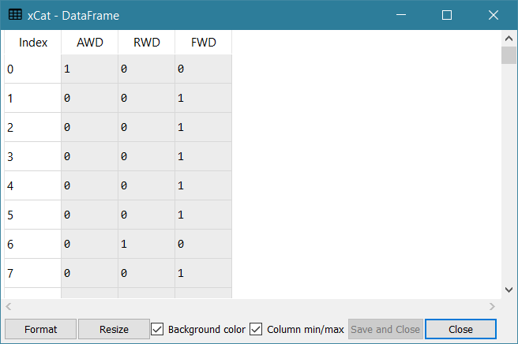
Select Mode as Reference Category
--- Frequency of Origin ---
Asia 158
USA 147
Europe 123
Name: Origin, dtype: int64
--- Frequency of DriveTrain ---
FWD 226
RWD 110
AWD 92
Name: DriveTrain, dtype: int64
Target Categories:
Index(['Asia', 'USA', 'Europe'], dtype='object')
Week 7 Cars Logistic Forward Selection.py

Slide 75
MNL: Forward Selection
Week 7 Cars Logistic Forward Selection.py
# Train a Logistic Regression model using the Forward Selection method
devianceTable = pandas.DataFrame()
u = pandas.DataFrame()
# Step 0: Intercept only model
u = y.isnull()
designX = pandas.DataFrame(u.where(u, 1)).rename(columns = {yName: "const"})
LLK0, DF0, fullParams0, thisFit = build_mnlogit (designX, y)
devianceTable = devianceTable.append([[0, 'Intercept', DF0, LLK0, None, None, None]])

Slide 76
MNL: Forward Selection
Week 7 Cars Logistic Forward Selection.py
# Step 1.1: Intercept + 'DriveTrain'
designX = xCat
designX = stats.add_constant(designX, prepend = True)
LLK1, DF1, fullParams1, thisFit = build_mnlogit (designX, y)
testDev = 2.0 * (LLK1 - LLK0)
testDF = DF1 - DF0
testPValue = scipy.stats.chi2.sf(testDev, testDF)
devianceTable = devianceTable.append([[1.1, 'Intercept + DriveTrain',
DF1, LLK1, testDev, testDF, testPValue]])
# Step 1.2: Intercept + 'Weight'
designX = xInt
designX = stats.add_constant(designX, prepend = True)
LLK1, DF1, fullParams1, thisFit = build_mnlogit (designX, y)
testDev = 2.0 * (LLK1 - LLK0)
testDF = DF1 - DF0
testPValue = scipy.stats.chi2.sf(testDev, testDF)
devianceTable = devianceTable.append([[1.2, 'Intercept + Weight', DF1, LLK1, testDev, testDF, testPValue]])

Slide 77
MNL: Forward Selection
Week 7 Cars Logistic Forward Selection.py
# Step 2.1: Intercept + 'DriveTrain' + 'Weight'
# Note: Since Pandas will not append a non-categorical index (as in xInt) to a categorical index
# (as in xCat) but will append in another direction, so we append xCat to xInt instead.
# The model is still the same.
designX = xInt
designX = designX.join(xCat)
designX = stats.add_constant(designX, prepend = True)
LLK1, DF1, fullParams1, thisFit = build_mnlogit (designX, y)
testDev = 2.0 * (LLK1 - LLK0)
testDF = DF1 - DF0
testPValue = scipy.stats.chi2.sf(testDev, testDF)
devianceTable = devianceTable.append([[2.1, 'Intercept + Weight + DriveTrain', DF1, LLK1, testDev, testDF, testPValue]])
devianceTable = devianceTable.rename(columns = {0:'Sequence', 1:'Model Specification',
2:'Number of Free Parameters', 3:'Log-Likelihood',
4:'Deviance', 5:'Degree of Freedom', 6:'Significance'})

Slide 78
MNL: Forward Selection
Week 7 Cars Logistic Forward Selection.py
Sequence | Model Specification | Number of Free Parameters | Log-Likelihood | Deviance | Degree of Freedom | Significance
0 | Intercept | 2 | -467.9224
1.1 | Intercept + DriveTrain | 6 | -447.1785 | 41.4879 | 4 | 2.1299E-08
1.2 | Intercept + Weight | 4 | -451.4704 | 32.9041 | 2 | 7.1610E-08
Since all Chi-Square Significance values are less than 0.05, both DriveTrain and Weight both can improve model goodness-of-fit.
Since DriveTrain’s Chi-Square Significance value is smallest, we will first enter DriveTrain into the model.
Step 1 produces Model 1 which is Intercept + DriveTrain

Slide 79
MNL: Forward Selection
Week 7 Cars Logistic Forward Selection.py
Sequence | Model Specification | Number of Free Parameters | Log-Likelihood | Deviance | Degree of Freedom | Significance
1 | Intercept + DriveTrain | 6 | -447.1785
2.1 | Intercept + Weight + DriveTrain | 8 | -426.7579 | 40.8412 | 2 | 1.3535E-09
Since the Chi-Square Significance from adding Weight to Model 1 is less than 0.05, we conclude that Weight can improve model goodness-of-fit.
Therefore, we enter Weight into the model.
Step 2 produces Model 2 which is Intercept + Weight + DriveTrain
Since there are no more predictors for consideration, the Forward Selection stops.

Slide 80
MNL: Backward Selection
Model 0: Origin = Intercept + DriveTrain + Weight
In other words, it is the Full Main Effect model
Consider Model 1: Origin = Intercept + DriveTrain + Weight - <predictor> <predictor> = DriveTrain, Weight
Calculate the Deviance test statistic and then use the Chi-square significance value to determine if the <predictor> will improve model goodness-of-fit
Week 7 Cars Logistic Backward Selection.py

Slide 81
MNL: Backward Selection
Index | Model Form | Number of Free Parameters | Log-Likelihood | Deviance | Degrees of Freedom | Chi-Square Significance
0 | Intercept + DriveTrain + Weight | 8 | -426.7579
1.1 | Intercept + Weight | 4 | -451.4704 | 49.4250 | 4 | 4.7604e-10
1.2 | Intercept + DriveTrain | 6 | -447.1785 | 40.8412 | 2 | 1.3535e-09
Since all Chi-Square Significance values are not greater than 0.05, removing either DriveTrain or Weight both will reduce model goodness-of-fit.
Therefore, no predictors can be removed.
The Backward Selection stops at Model 0: Intercept + DriveTrain + Weight

Slide 82
Mid-Term Test
A take-home test
Instructions on Blackboard
Cover topics from Week 1 to Week 7 inclusively
Will be available from 12:01 am on Wednesday, October 14, 2020
Submit your answers before 11:59 pm on Tuesday, October 20, 2020
Absolutely No Extension!

